Slide 1
G D 2 1 0
Game Studio - Prof. Alec McClure

Slide 2
Last week...

Slide 3
Conceptualization
Pre-production
Production
QA/Polish
What is it?
Why make it?
What makes it unique?
Which tools?
What skills/roles will you need? e.g. Graphic Artist, Programmer, etc.
If you lack the skills or personnel, how will you source assets?
Start exploring and creating prototypes
Implementation
Building overall game arch. and moving into details from there.
Fix technical problems, add finishing touches, effects
“tweaking variables”
review
Notes:
REVIEW

Slide 4
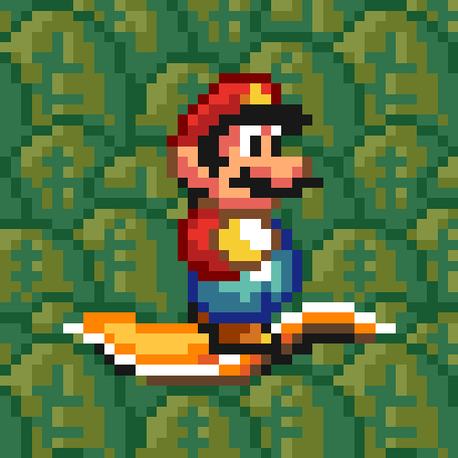
ASSIGNMENT
Reading:
RR1:
Rogers: Ch1/Who Makes This Stuff?
Write a reaction paper to the reading. min one-page (approx. 300 words)

Slide 5
Discuss!

Slide 6
How does Rogers
define a game?
Notes:
An activity that has:
-at least 1 player
-objective
-has rules
“A game is an activity with rules and a victory condition.”

Slide 7
Are these games?
Walking simulators, Visual Novels
Notes:
Why dont people like them? non-challenging / non-competitive
https://www.youtube.com/watch?v=wctIiiFsQxY
Dan Pinchbeck, one of the creators of Dear Esther, offered up some illuminating thoughts on the subject. Speaking to PCGamesN he said, "The idea that games have to be defended from innovation is new, as well as being something which I just don’t agree with. It’s not a conversation I ever remember having up until a few years ago."

Slide 8
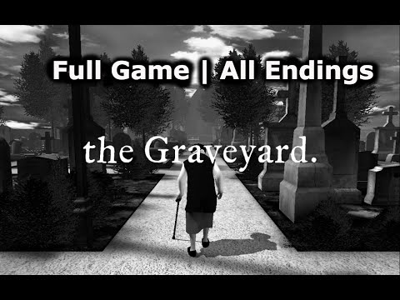

Slide 9
What does Rogers say about fun?
Notes:
Lose objectivity
un-fun - instead of fun, start with fun idea and then remove un-fun
remove bad mechanics and ugly art
negative design perspective

Slide 10
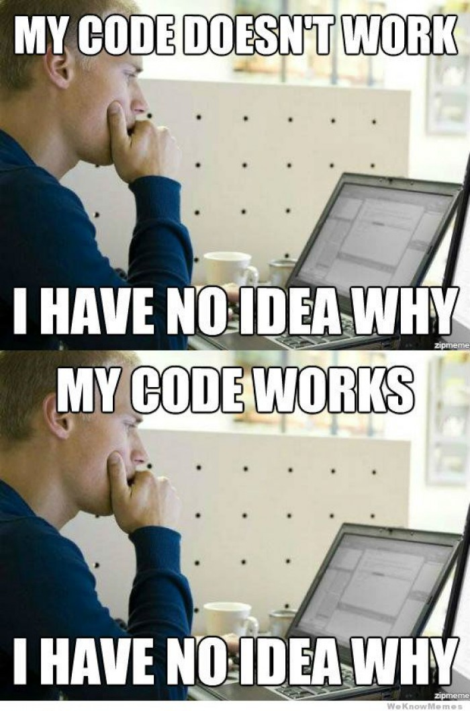
Roles
Programmer
e.g. John Romero

Slide 11
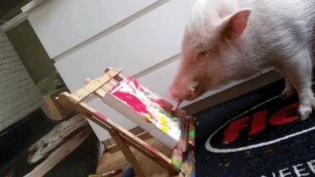
Le Artiste
Concept Artist
Storyboard Artist
3D Modelers+
Texture Artists
UI Designers
Animators

Slide 12
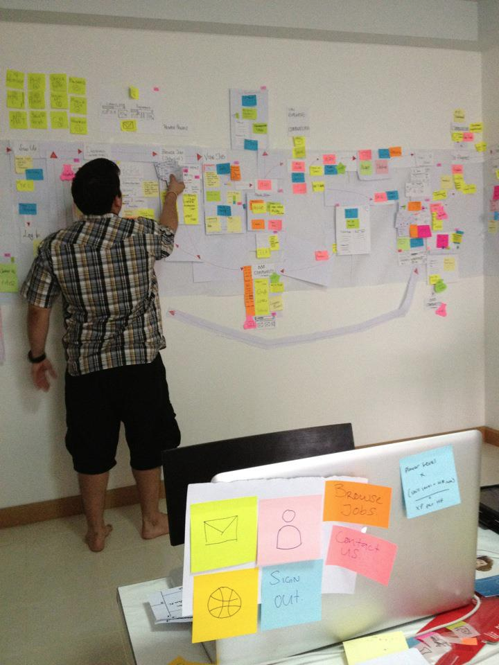
Designers
Game designer
Level designer
Systems designer

Slide 13
Art Director
An art director can help the team globalize the visual language of their game to make it clear to the player.
Creative Director
The creative director is known to guide a team of employees with skills and experience related to graphic design, fine arts, motion graphics, and other creative industry fields. Some example works can include visual layout, brainstorming, and copy writing.

Slide 14
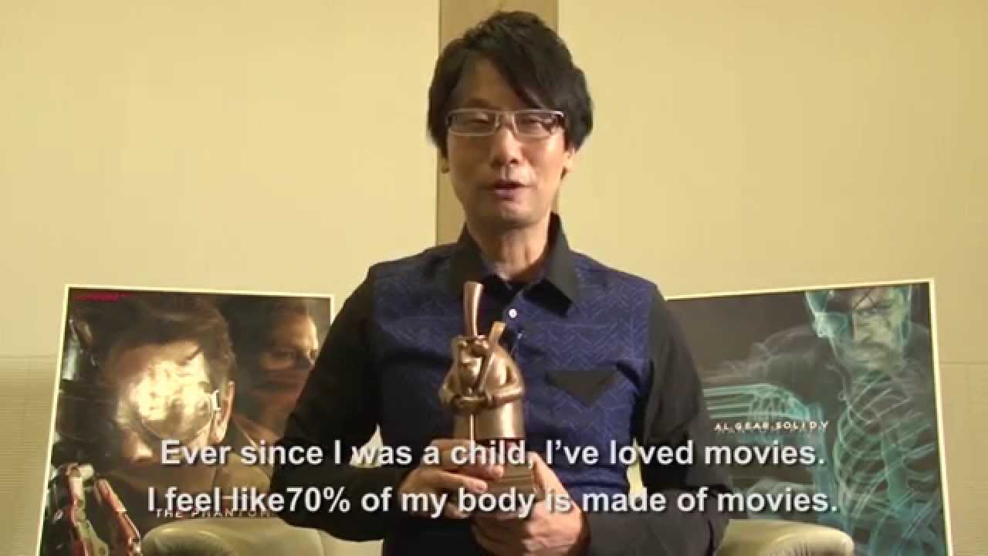
Producer

Slide 15

Tester

Slide 16
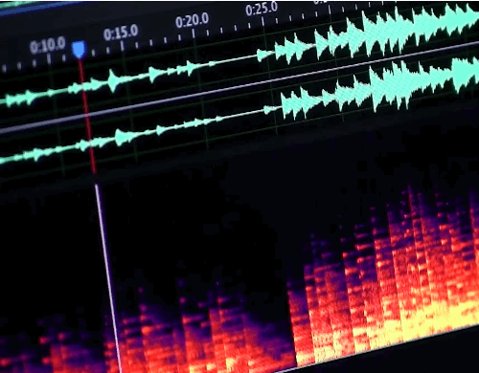
Composer
Sound designer

Slide 17

Writer
[ usually freelance ]

Slide 18
Want to be a game designer?

Slide 19


Slide 20
IRON DESIGNER CHALLENGE
borrowed from Brenda Romero
Notes:
3PM

Slide 21
Ideal job in game industry?

Slide 22


Slide 23
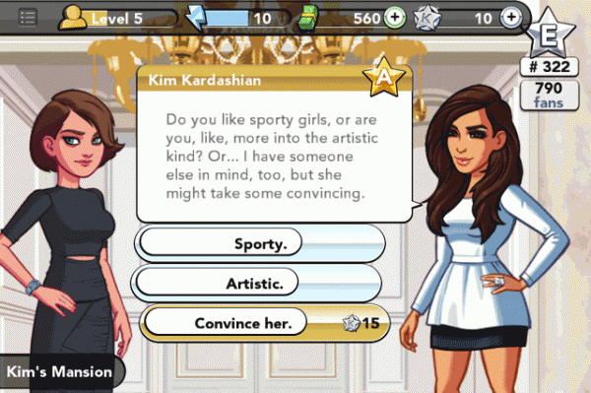

Slide 24
A designer needs to be good at turning anything into a game

Slide 25
Much of a designer’s early career will be dealing with IP

Slide 26

Intellectual Property
refers to creations of the mind, such as inventions; literary and artistic works; designs; and symbols, names and images used in commerce.

Slide 27
Bad IP/Good IP
What are some Good IPs and Bad IPs that haven’t been used to make games?
Notes:
newark central post office
avatar

Slide 28


Slide 29
Group Exercise #1
Steam downloadable
Core of the game
3 or 4 marketing points / features
Define avatar/character(s)
Estimate budget
Estimate release date

Slide 30

**RING RING**
A MESSAGE FROM
THE PUBLISHER

Slide 31

WE’RE GOING MOBILE

Slide 32
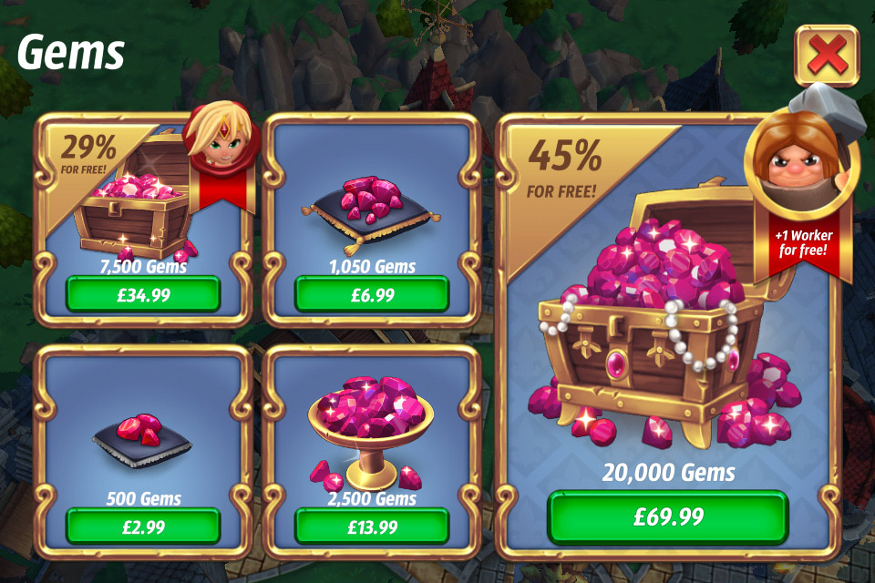
OH YEAH, MOBILE F2P

Slide 33
20 minutes

Slide 34


Slide 35
Please collect your “pink slips” and rearrange yourselves into new groups

Slide 36
“We’re completely rebooting this thing!”
-Publisher

Slide 37
“We’re going VR!”
-Publisher

Slide 38
Group Exercise #1
How do players interact with the game?
How do players interact with each other?
How can players help each other (cooperation)?
How can players hurt each other (competition)?

Slide 39
How many of you like your studio’s game?
Notes:
everyone

Slide 40
You can make a game
about anything

Slide 41
HOMEWORK
Read
Game Design Workshop, Fullerton - Chapter 15
(“Understanding the Game Industry,” p.413-435)
RR2
One to two page response to reading and lecture. (400 word minimum)

